Slide 1
Artificial Intelligence- Expert Systems
By: Anjali Kumari

Slide 2
What is Expert System?
knowledge based software that intakes information about its system and solves complex problems using the reasoning procedure that, on the other hand, are only expected from gifted individuals

Slide 3
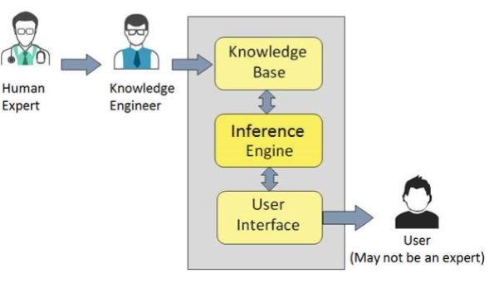
The three components
knowledge base: accumulates both factual and heuristic information for the expert systems.
Inference engine: consumes the data provided by the user and utilizes the knowledge base to provide an accurate suggestion or a solution to the given information
user interface: allows the interaction between the user and the Expert systems

Slide 4
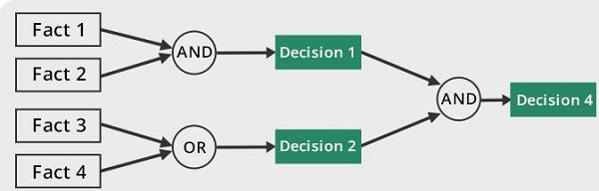
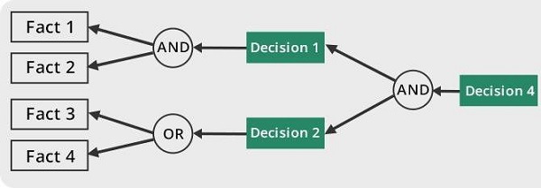
Two approaches
Forward chaining:
Backward Chaining:

Slide 5
How is it useful?
Used in industries like:
Financial services
Telecommunications
Healthcare
Customer service
transportation
videogames
manufacturing
aviation
written communication.

Slide 6
Citation
Inference in An Expert System I. (2005). Fuzzy Expert Systems and Fuzzy Reasoning, 99-113. doi:10.1002/0471698504.ch6
Point, T. (2017, August 15). Artificial Intelligence Expert Systems. Retrieved November 27, 2017
Press, L. (1989). Expert system benchmarks. IEEE Expert, 4(1), 37-44. doi:10.1109/64.21898
Tan, Wahidin, Khalil. What is expert system? (n.d.). Retrieved November 27, 2017

